Slide 1
Project 1, Module 4
Lucas Ross

Slide 2

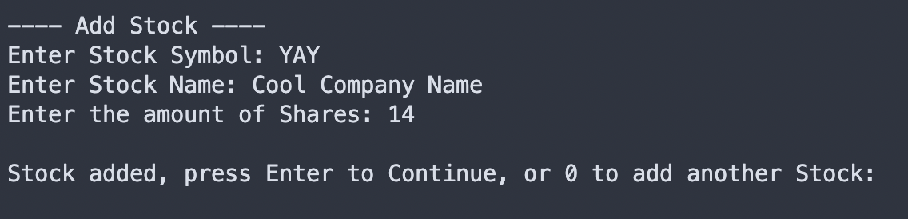
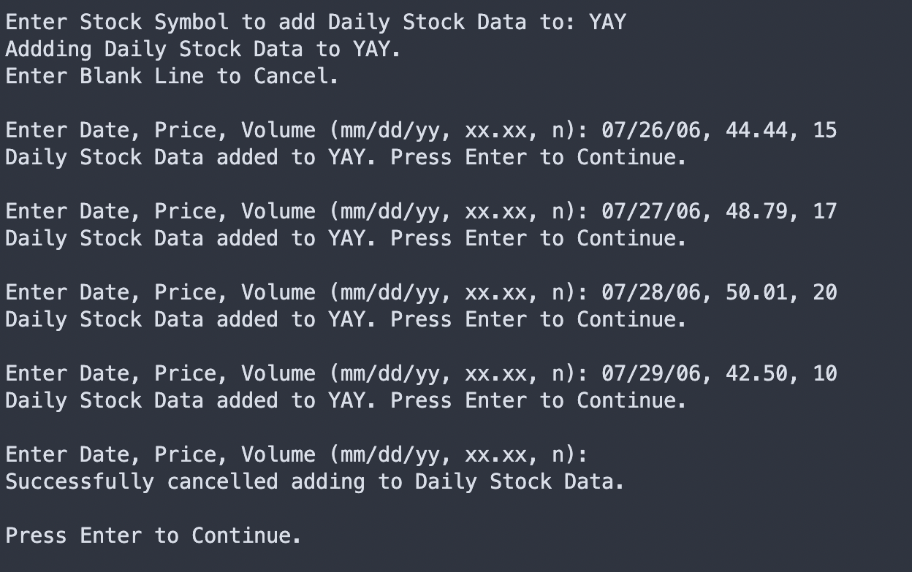
Adding a Stock and Daily Data
Stock Info:
[YAY]
Cool Company Name
14 Shares
Daily Data:
07/26/06, 44.44, 15
07/27/06, 48.79, 17
07/28/06, 50.01, 20
07/29/06, 42.50, 10

Slide 3
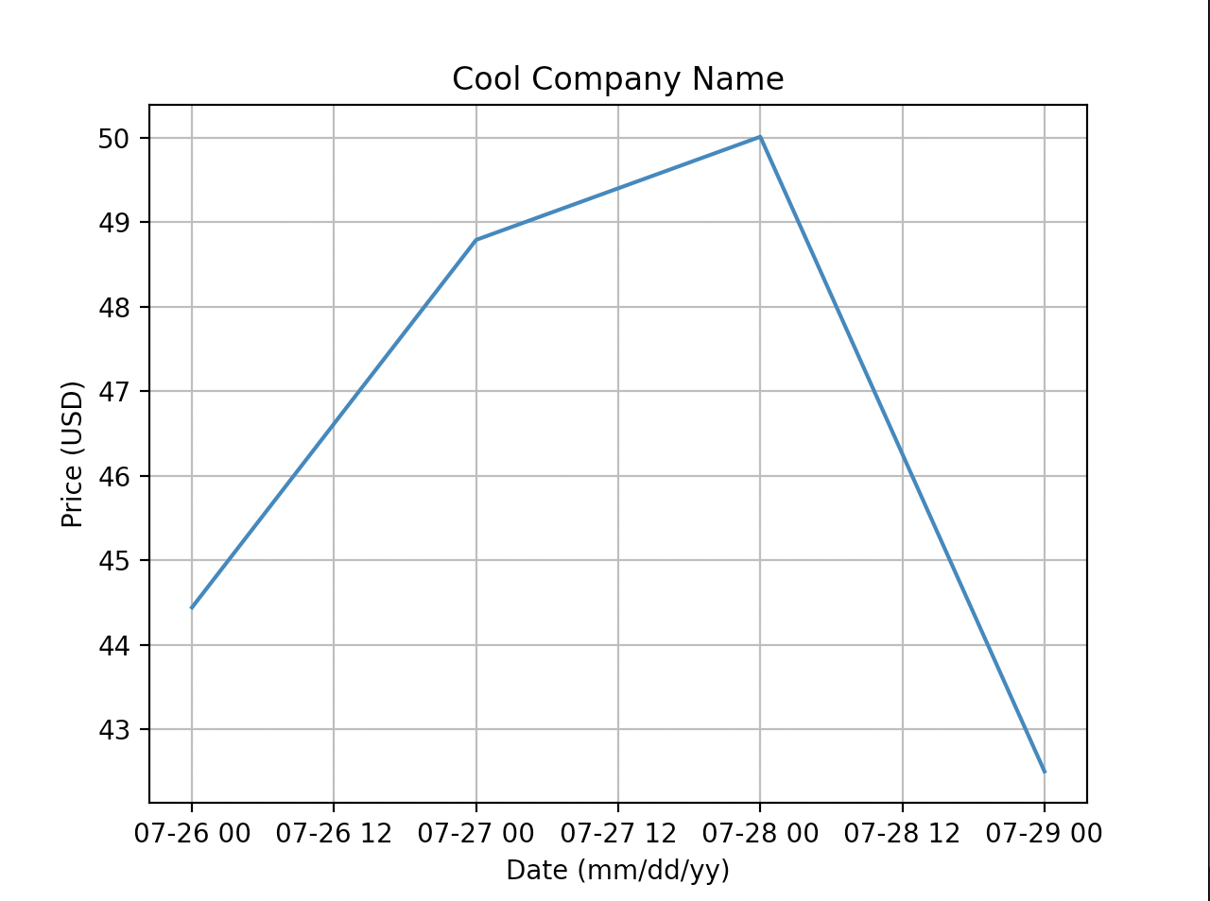
Displaying the Stock’s DailyData

